Slide 1

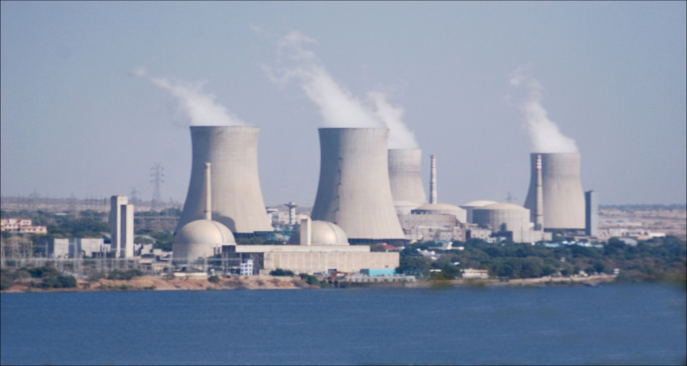
NUCLEAR POWER BY 2030
Presentation by
Rohit Banerjee
Director (Projects), NPCIL
Nuclear Power Corporation of India Ltd

Slide 2
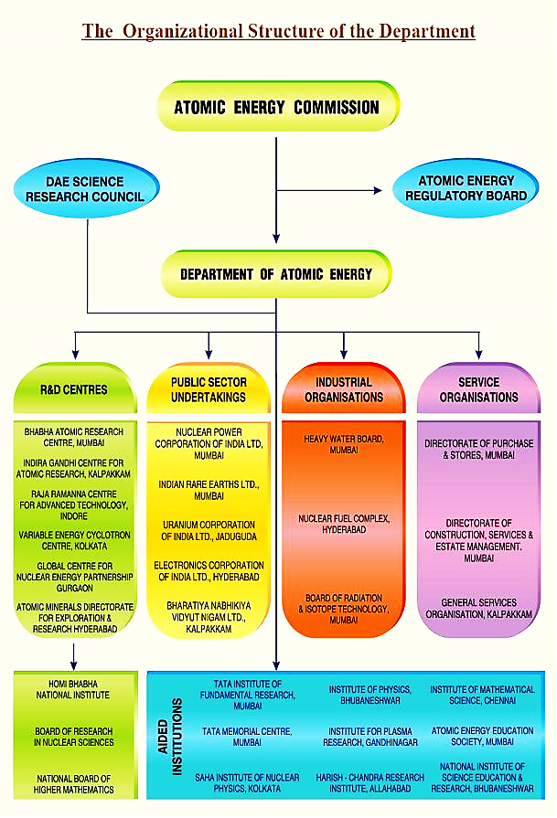



Slide 3
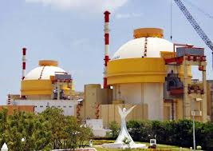
Indian Nuclear Power Programme
Indigenous Three-stage Programme
Natural
10 GWe
Uranium
PHWR
ELECTRICITY
Th
Depleted U
300 GWe
Th
Pu FUELLED
ELECTRICITY
Pu
FAST BREEDERS
U
-
233 FUELLED
Huge
Pu
U
-
233
BREEDERS
ELECTRICITY
U
-
233
STAGE 1
STAGE 2
STAGE 3
Additionalities
(LWRs with International cooperation)

Slide 4
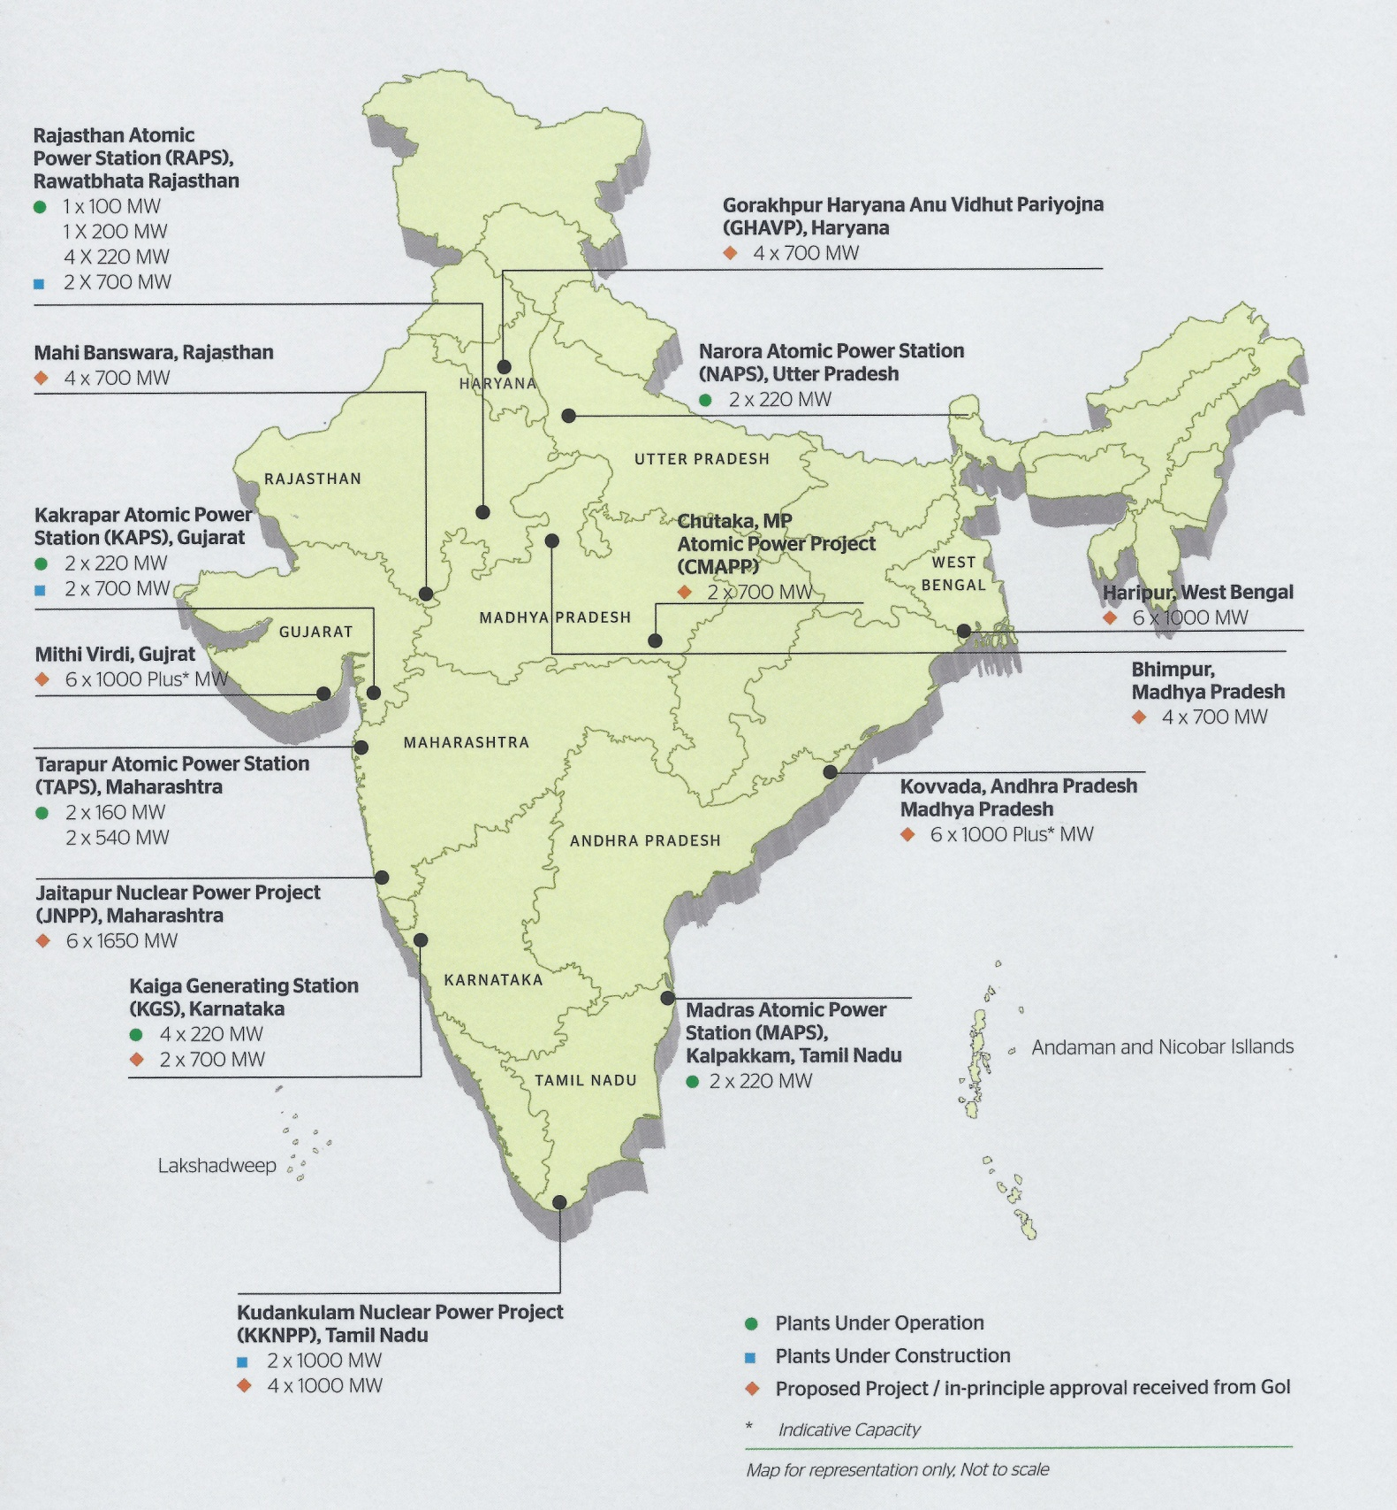
NPCIL
Present & near Future

Slide 5
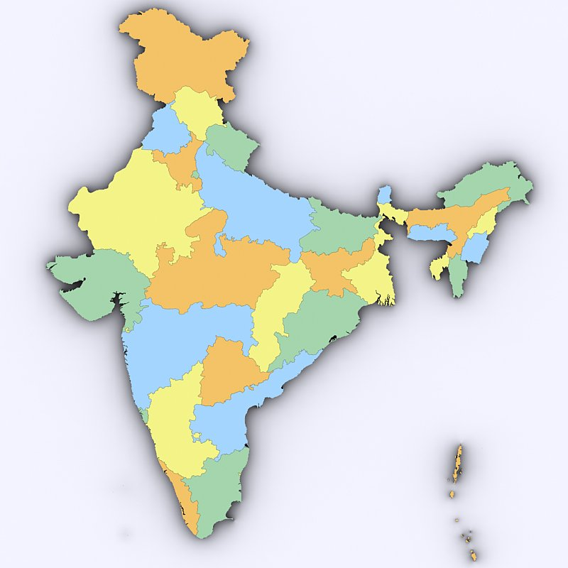
Operating Reactors
18 PHWRs = 4460 MW
RAPS-1 | PHWR | 100 MWe
RAPS-2 | PHWR | 200 MWe
MAPS-1 | PHWR | 220 MWe
MAPS-2 | PHWR | 220 MWe
NAPS-1 | PHWR | 220 MWe
NAPS-2 | PHWR | 220 MWe
KAPS-1 | PHWR | 220 MWe
KAPS-2 | PHWR | 220 MWe
KAIGA-2 | PHWR | 220 MWe
RAPS-3 | PHWR | 220 MWe
KAIGA-1 | PHWR | 220 MWe
RAPS-4 | PHWR | 220 MWe
TAPS-4 | PHWR | 540 MWe
TAPS-3 | PHWR | 540 MWe
KAIGA-3 | PHWR | 220 MWe
RAPS-5 | PHWR | 220 MWe
RAPS-6 | PHWR | 220 MWe
KAIGA-4 | PHWR | 220 MWe
6780 MW
Rajasthan Atomic Power
Station (RAPS) Rajasthan
1x100 MW
1x200 MW
4x220 MW
Narora Atomic Power
Station (TAPS) Uttar Pradesh
2x220 MW
Tarapur Atomic Power
Station (TAPS) Maharashtra
2x220 MW
2x540 MW
Kaiga Generating Station
Karnataka
4x220 MW
Madras Atomic Power
Station (MAPS) Kalpakkam, TN
2x220 MW
2 BWRs = 320 MW
TAPS-1 | BWR | 160 MWe
TAPS-2 | BWR | 160 MWe
2 VVER = 2000 MW
KKNPP-1,2 | VVER | 2x1000 MWe

Slide 6
Reactors under Commissioning, Construction & launched
Launched
GHAVP1&82: 2x700 MW PHWR
Under construction
KAPP 3&4 :2x700 MW PHWR
RAPP 7&8 :2x700 MW PHWR
6700 MW
Under commissioning
PFBR : 1x500 MW
Launched
KKNPP 3&4 : 2x1000 MW LWR

Slide 7
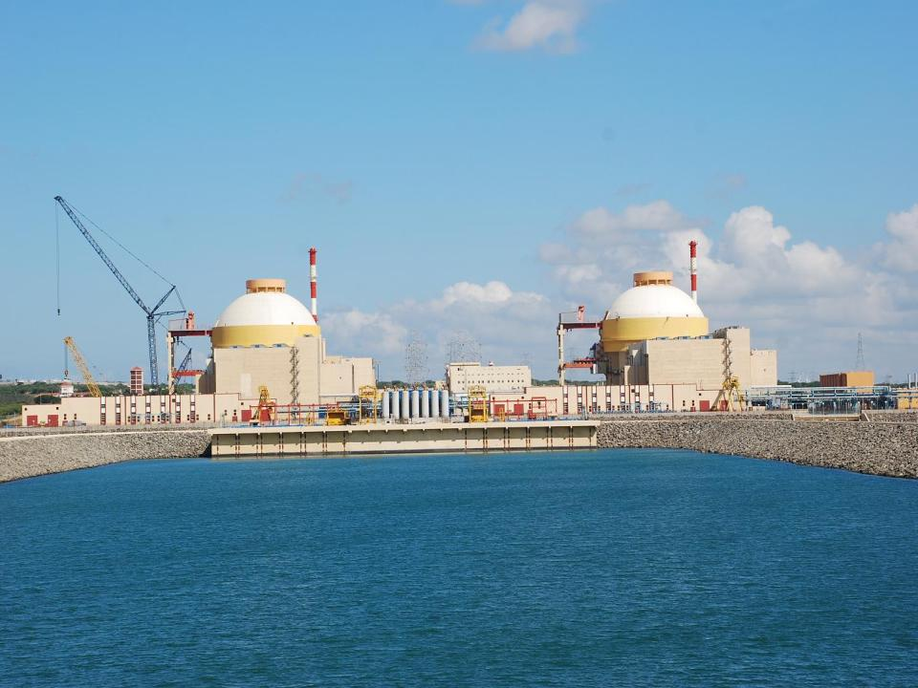
Reactor recently commissioned
KKNPP - 2 (1000 MW)

Slide 8
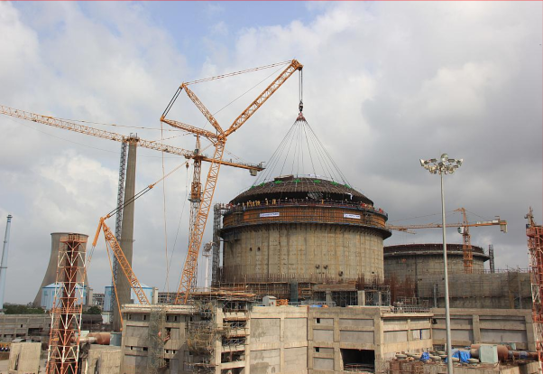
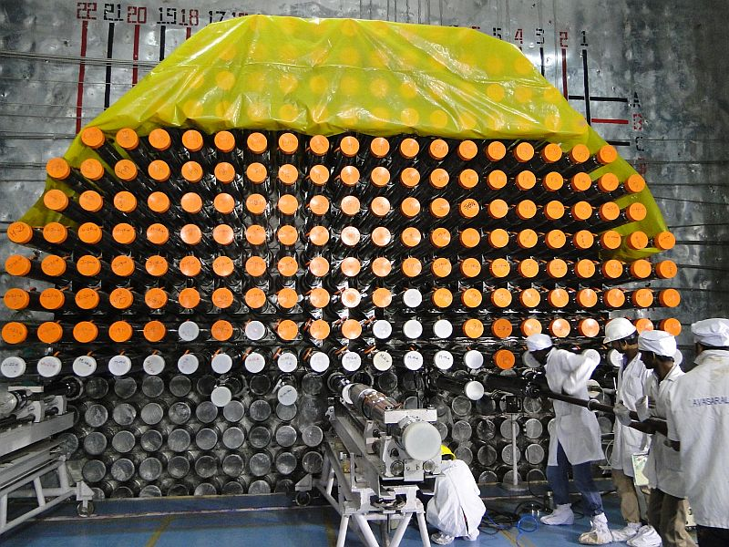
Reactors under Construction
– KAPP 3&4 (2X700 MW PHWR)
Physical Progress 75% (as of Sept 2016)

Slide 9
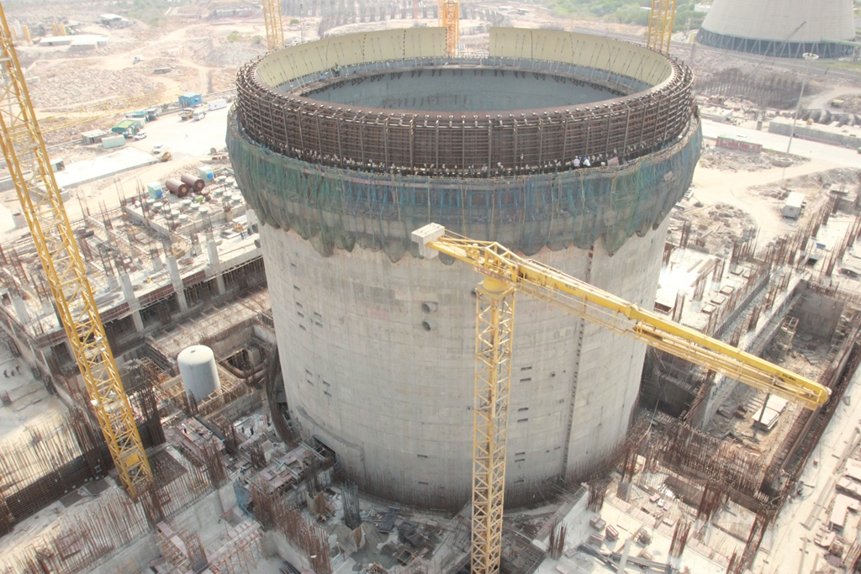
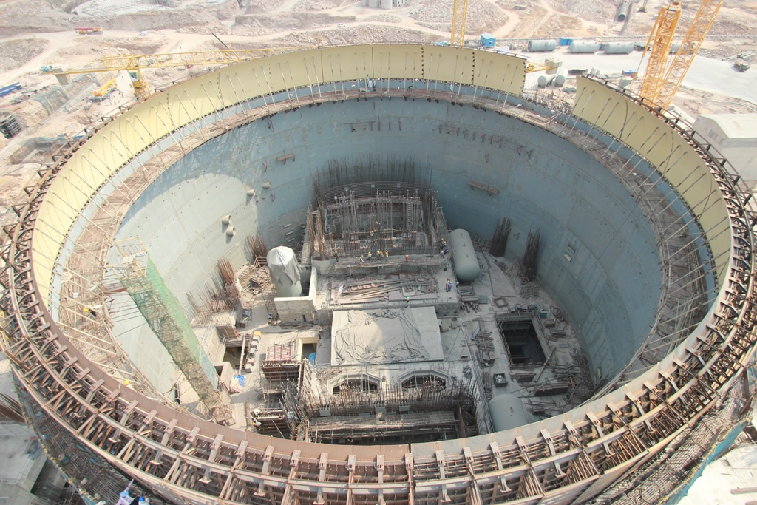
Reactors under Construction
– RAPP 7&8 (2X700 MW PHWR)
RAPP-7
Physical Progress 61% (as of Sept 2016)

Slide 10
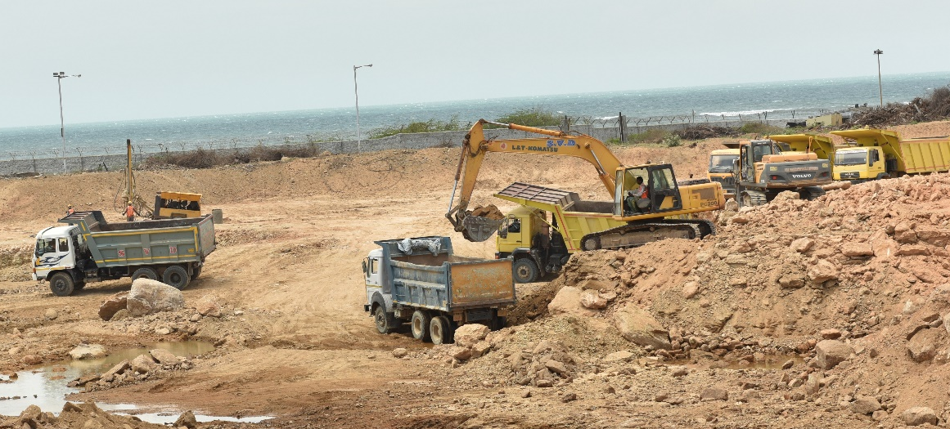
Projects Launched
KKNPP 3&4 (2 X 1000 MW)
at Kudankulam, Tamilnadu
Excavation in Progress
GHAVP 1&2 (2 X 700 MW)
at Gorakhpur, Haryana
being readied for launch

Slide 11
NUCLEAR POWER PROJECTION
Need for capacity about 778 GWe by the year 2032 for a growth rate of 8% (as per Integrated Energy Policy of India).
Integrated Energy Policy envisages 63 GWe (63000 MWe) from nuclear power.
The capacity addition plan (63000 MWe) for Nuclear envisages:
  11200 MWe from indigenous PHWRs
  34100 MW from LWRs
  balance through 500-MWe/1000-MWe Fast Breeder Reactors (FBRs) and Advanced Heavy Water Reactor (AHWR)
  (in addition to the existing capacity of 6780MWe in operation and 6700 under construction)
June 2016
11

Slide 12
Reactors under planning and negotiation
Indian PHWRs
2x700 MW, Chutaka,MP
4x700 MW, Mahi-Banswara, Raj
2x700 MW, Kaiga,Karnataka
2x700 MW, GHAVP, Haryana
4x700 MW, Bhimpur, MP
Fast Breeder Reactors
2x500 MW by Bhavini, Kalpakkam
Light Water Reactos Under IGA
2x1000 MW, Kudankulam-5&6, TN. VVER by ASE, Russia
6x1650 MW, Jaitapur, Maharashtra. EPR by EDF, France
6x1000 MW, Kovvada, AP, AP1000 by WEC, USA
6x1000 MW, Chhaya-Mithi,Gujarat.
6x1000 MW, Haripur, WB. VVER by ASE, Russia

Slide 13
NUCLEAR CAPACITY BUILD-UP

Slide 14
PROJECT IMPLEMENTATION STRATEGY
10 PHWR Reactors to be implemented on a fleet mode
LWR parks of about 6 reactors of same technology
Simultaneous orders for Long manufacturing cycle equipment with a reasonable staggering.
Gap of one year or less in each reactor
Financing options
  Internal Accruals/ Government Budgetary Support/ JVs for equity
  Debt financing from sourcing country of international LWR projects
  Borrowings from Market

Slide 15
Challenges
Land availability and infrastructure
Project gestation period
  Timely completion of Pre-project activities including statutory clearances.
  Optimisation project completion period
Qualified Human Resources
Industry’s preparedness to support the program
Localisation of LWR components / equipment / O&M spares
Availability of finance
Tariff competiveness
  Optimum per megawatt overnight cost
  Finance at lower interest rates

Slide 16
Performance - Competitive Tariffs
(Operating stations)
Paise/Unit

Slide 17
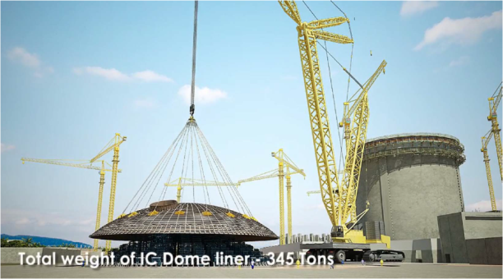
ENHANCED MODULERIZATION

Slide 18
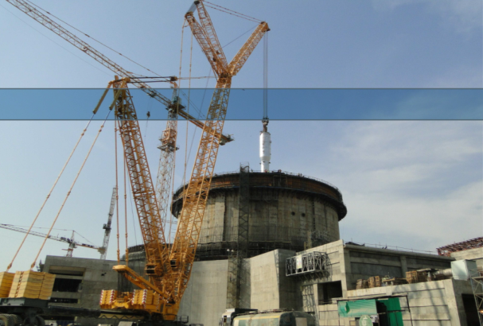
ENHANCED MODULERIZATION

Slide 19
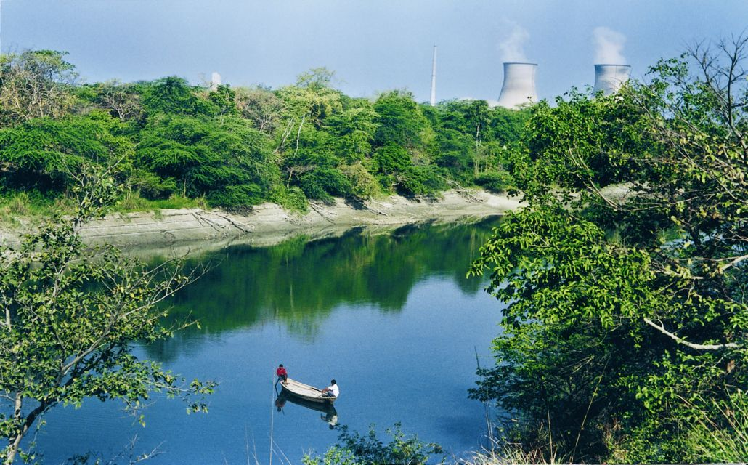
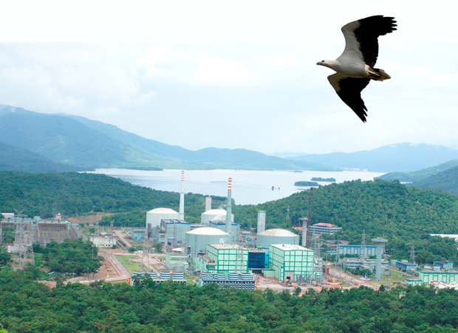
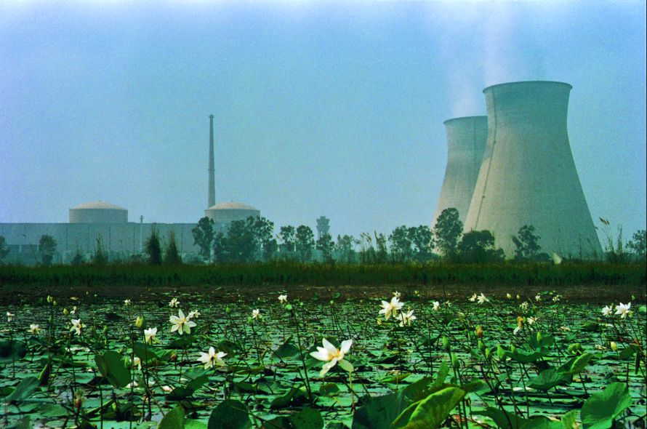
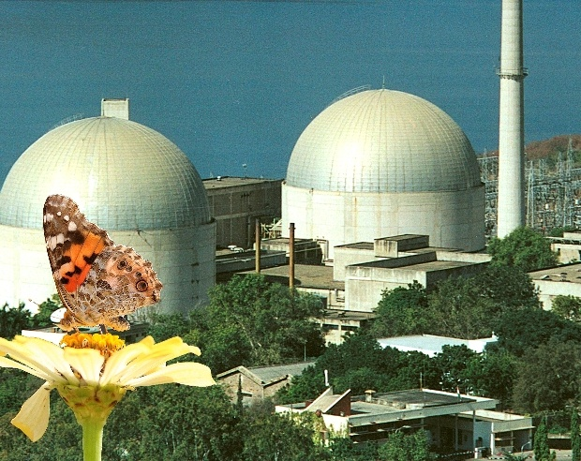
THANKS
Safety first - Environment foremost

Slide 20
ALL INDIA INSTALLED CAPACITY
OF POWER STATIONS (31.8.2016)
All India per capita consumption of electricity for the year 2015-16 was 1075 kwh (Provisional)
Note: Captive power is not included in total
Source: CEA

